Slide 1

Contiguous Memory Allocation
The memory is usually divided into two partitions: one for the resident operating system and one for the user processes.
In contiguous memory allocation, each process is contained in a single section of memory that is contiguous to the section containing the next process.

Slide 2
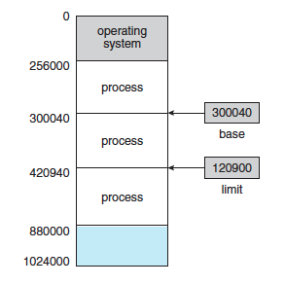
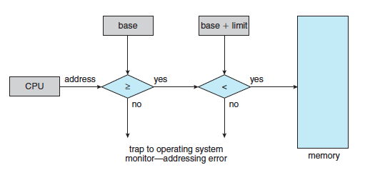
Contiguous Memory Allocation
Single-partition allocation
Relocation-register scheme used to protect user processes from each other, and from changing operating-system code and data.
Relocation register contains value of smallest physical address; limit register contains range of logical addresses – each logical address must be less than the limit register.

Slide 3
Contiguous Memory Allocation
Fixed Partition
One of the simplest methods for allocating memory is to divide memory into several fixed-sized partitions.
Each partition may contain exactly one process.
Thus, the degree of multiprogramming is bound by the number of partitions.
In this multiple partition method, when a partition is free, a process is selected from the input queue and is loaded into the free partition.
When the process terminates, the partition becomes available for another process

Slide 4
Contiguous Memory Allocation
Variable Partition
the operating system keeps a table indicating which parts of memory are available and which are occupied.
Hole - Initially, all memory is available for user processes and is considered one large block of available memory, a hole
Eventually, as you will see, memory contains a set of holes of various sizes.

Slide 5
Contiguous Memory Allocation
Variable Partition
As processes enter the system, they are put into an input queue.
The operating system takes into account the memory requirements of each process and the amount of available memory space in determining which processes are allocated memory.
When a process is allocated space, it is loaded into memory, and it can then compete for CPU time.
When a process terminates, it releases its memory, which the operating system may then fill with another process from the input queue.

Slide 6
Contiguous Memory Allocation
Variable Partition
In general, as mentioned, the memory blocks available comprise a set of holes of various sizes scattered throughout memory.
When a process arrives and needs memory, the system searches the set for a hole that is large enough for this process.
If the hole is too large, it is split into two parts. One part is allocated to the arriving process; the other is returned to the set of holes.
When a process terminates, it releases its block of memory, which is then placed back in the set of holes.

Slide 7
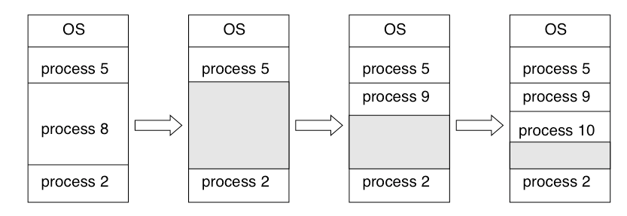
Contiguous Memory Allocation

Slide 8
Dynamic Storage Allocation Problem
How to satisfy a request of size n from a list of free holes.
First fit - Allocate the first hole that is big enough. Searching can start either at the beginning of the set of holes or at the location where the previous first-fit search ended. We can stop searching as soon as we find a free hole that is large enough.
Best fit - Allocate the smallest hole that is big enough. We must search the entire list, unless the list is ordered by size. This strategy produces the smallest leftover hole.
Worst fit - Allocate the largest hole. Again, we must search the entire list, unless it is sorted by size. This strategy produces the largest leftover hole, which may be more useful than the smaller leftover hole from a best-fit approach.

Slide 9
Dynamic Storage Allocation Problem
Both first fit and best fit are better than worst fit in terms of decreasing time and storage utilization.
Neither first fit nor best fit is clearly better than the other in terms of storage utilization, but first fit is generally faster.

Slide 10
Fragmentation
External Fragmentation
Both the first-fit and best-fit strategies for memory allocation suffer from external fragmentation.
As processes are loaded and removed from memory, the free memory space is broken into little pieces.
External fragmentation exists when there is enough total memory space to satisfy a request but the available spaces are not contiguous: storage is fragmented into a large number of small holes.
This fragmentation problem can be severe. In the worst case, we could have a block of free (or wasted) memory between every two processes.
If all these small pieces of memory were in one big free block instead, we might be able to run several more processes.

Slide 11
Fragmentation
Internal Fragmentation
Consider a multiple-partition allocation scheme with a hole of 18,464 bytes. Suppose that the next process requests 18,462 bytes.
If we allocate exactly the requested block, we are left with a hole of 2 bytes.
With this approach, the memory allocated to a process may be slightly larger than the requested memory.
The difference between these two numbers is internal fragmentation—unused memory that is internal to a partition

Slide 12
Fragmentation
One solution to the problem of external fragmentation is compaction.
The goal is to shuffle the memory contents so as to place all free memory together in one large block.
If relocation is static and is done at assembly or load time, compaction cannot be done.
It is possible only if relocation is dynamic and is done at execution time.
The simplest compaction algorithm is to move all processes toward one end of memory; all holes move in the other direction, producing one large hole of available memory.
This scheme can be expensive.

Slide 13


THANK YOU

